Slide 1

Foreach and Multidimensional Arrays
Lecturer
Rokas Slaboševičius
Data

Slide 2
Today you will learn
Foreach and Multidimensional Arrays
Foreach
01
What are two-dimensional arrays?
02
When to use two-dimensional arrays?
03

Slide 3


Foreach
Foreach and Multidimensional Arrays
The foreach loop is a useful C# programming construct that makes it easy to view and manipulate items in collections or arrays.
This loop is very handy when we want to perform a specific action on each copy of a collection item

Slide 4
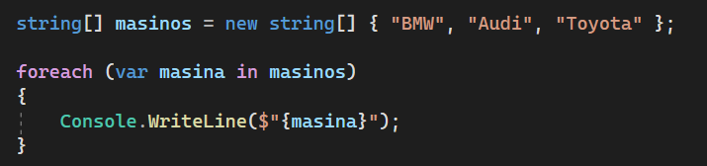
Foreach
Foreach and Multidimensional Arrays
The foreach loop is designed to view every copy of every item in the collection, from the first to the last.
This provides an easy way to iterate through a collection, regardless of its size or structure.
At each iteration, a copy of the collection item will be stored in the variable specified in the foreach construct, which we can then act on.

Slide 5

Foreach and Multidimensional Arrays
Task 1
USING FOREACH:
Write a method that returns the average of the numbers in an int one-dimensional array.
Write a method that returns positive numbers from int array containing both positive and negative numbers.
Write a method that accepts an array of payments and calculates the amount of VAT to be paid. Task VAT: 15%
Write a method that accepts a sentence but returns a new array containing all words that were greater than or equal to 5 letters

Slide 6
Foreach and Multidimensional Arrays
Task 1
Write a method ConstructDeck(types, cards). This method must construct a deck from the given 2 string arrays. Then write a method to print all your cards on the screen for example: Output - Ace of Diamonds, King of Diamonds, Queen of Diamonds, Jack of Diamonds... King of Clubs

Slide 7

What are two-dimensional arrays?
Foreach and Multidimensional Arrays
Two-dimensional arrays are a useful element of the C# programming language, allowing data to be organised and manipulated in a structured way.
Two-dimensional arrays are arrays that have more than one dimension, i.e. they can have more than one set of indices

Slide 8
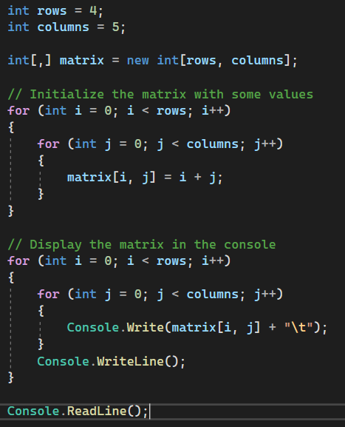

When to use two-dimensional arrays?
Foreach and Multidimensional Arrays
Matrices: two-dimensional arrays are ideal for representing matrices.
Matrices are used extensively in mathematical and statistical calculations, as well as in visualization, game programming and data analysis.

Slide 9
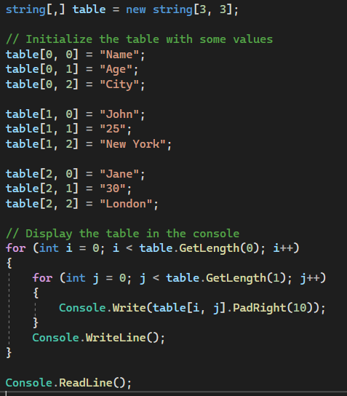

When to use two-dimensional arrays?
Foreach and Multidimensional Arrays
Tables: two-dimensional arrays can be used as data tables, where columns correspond to different data properties and rows correspond to records or groups of records.
This can be useful in database operations, table display or data manipulation.

Slide 10
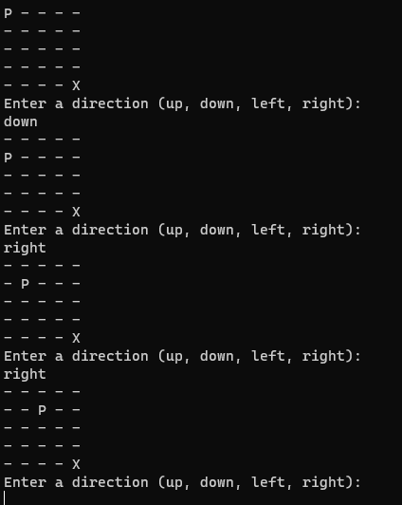
When to use two-dimensional arrays?
Foreach and Multidimensional Arrays
Game programming: two-dimensional arrays are often used in game development to represent game maps, player positions or object structures.
They help to organise and manipulate game data, such as the area of the map or the structure of the game levels.

Slide 11

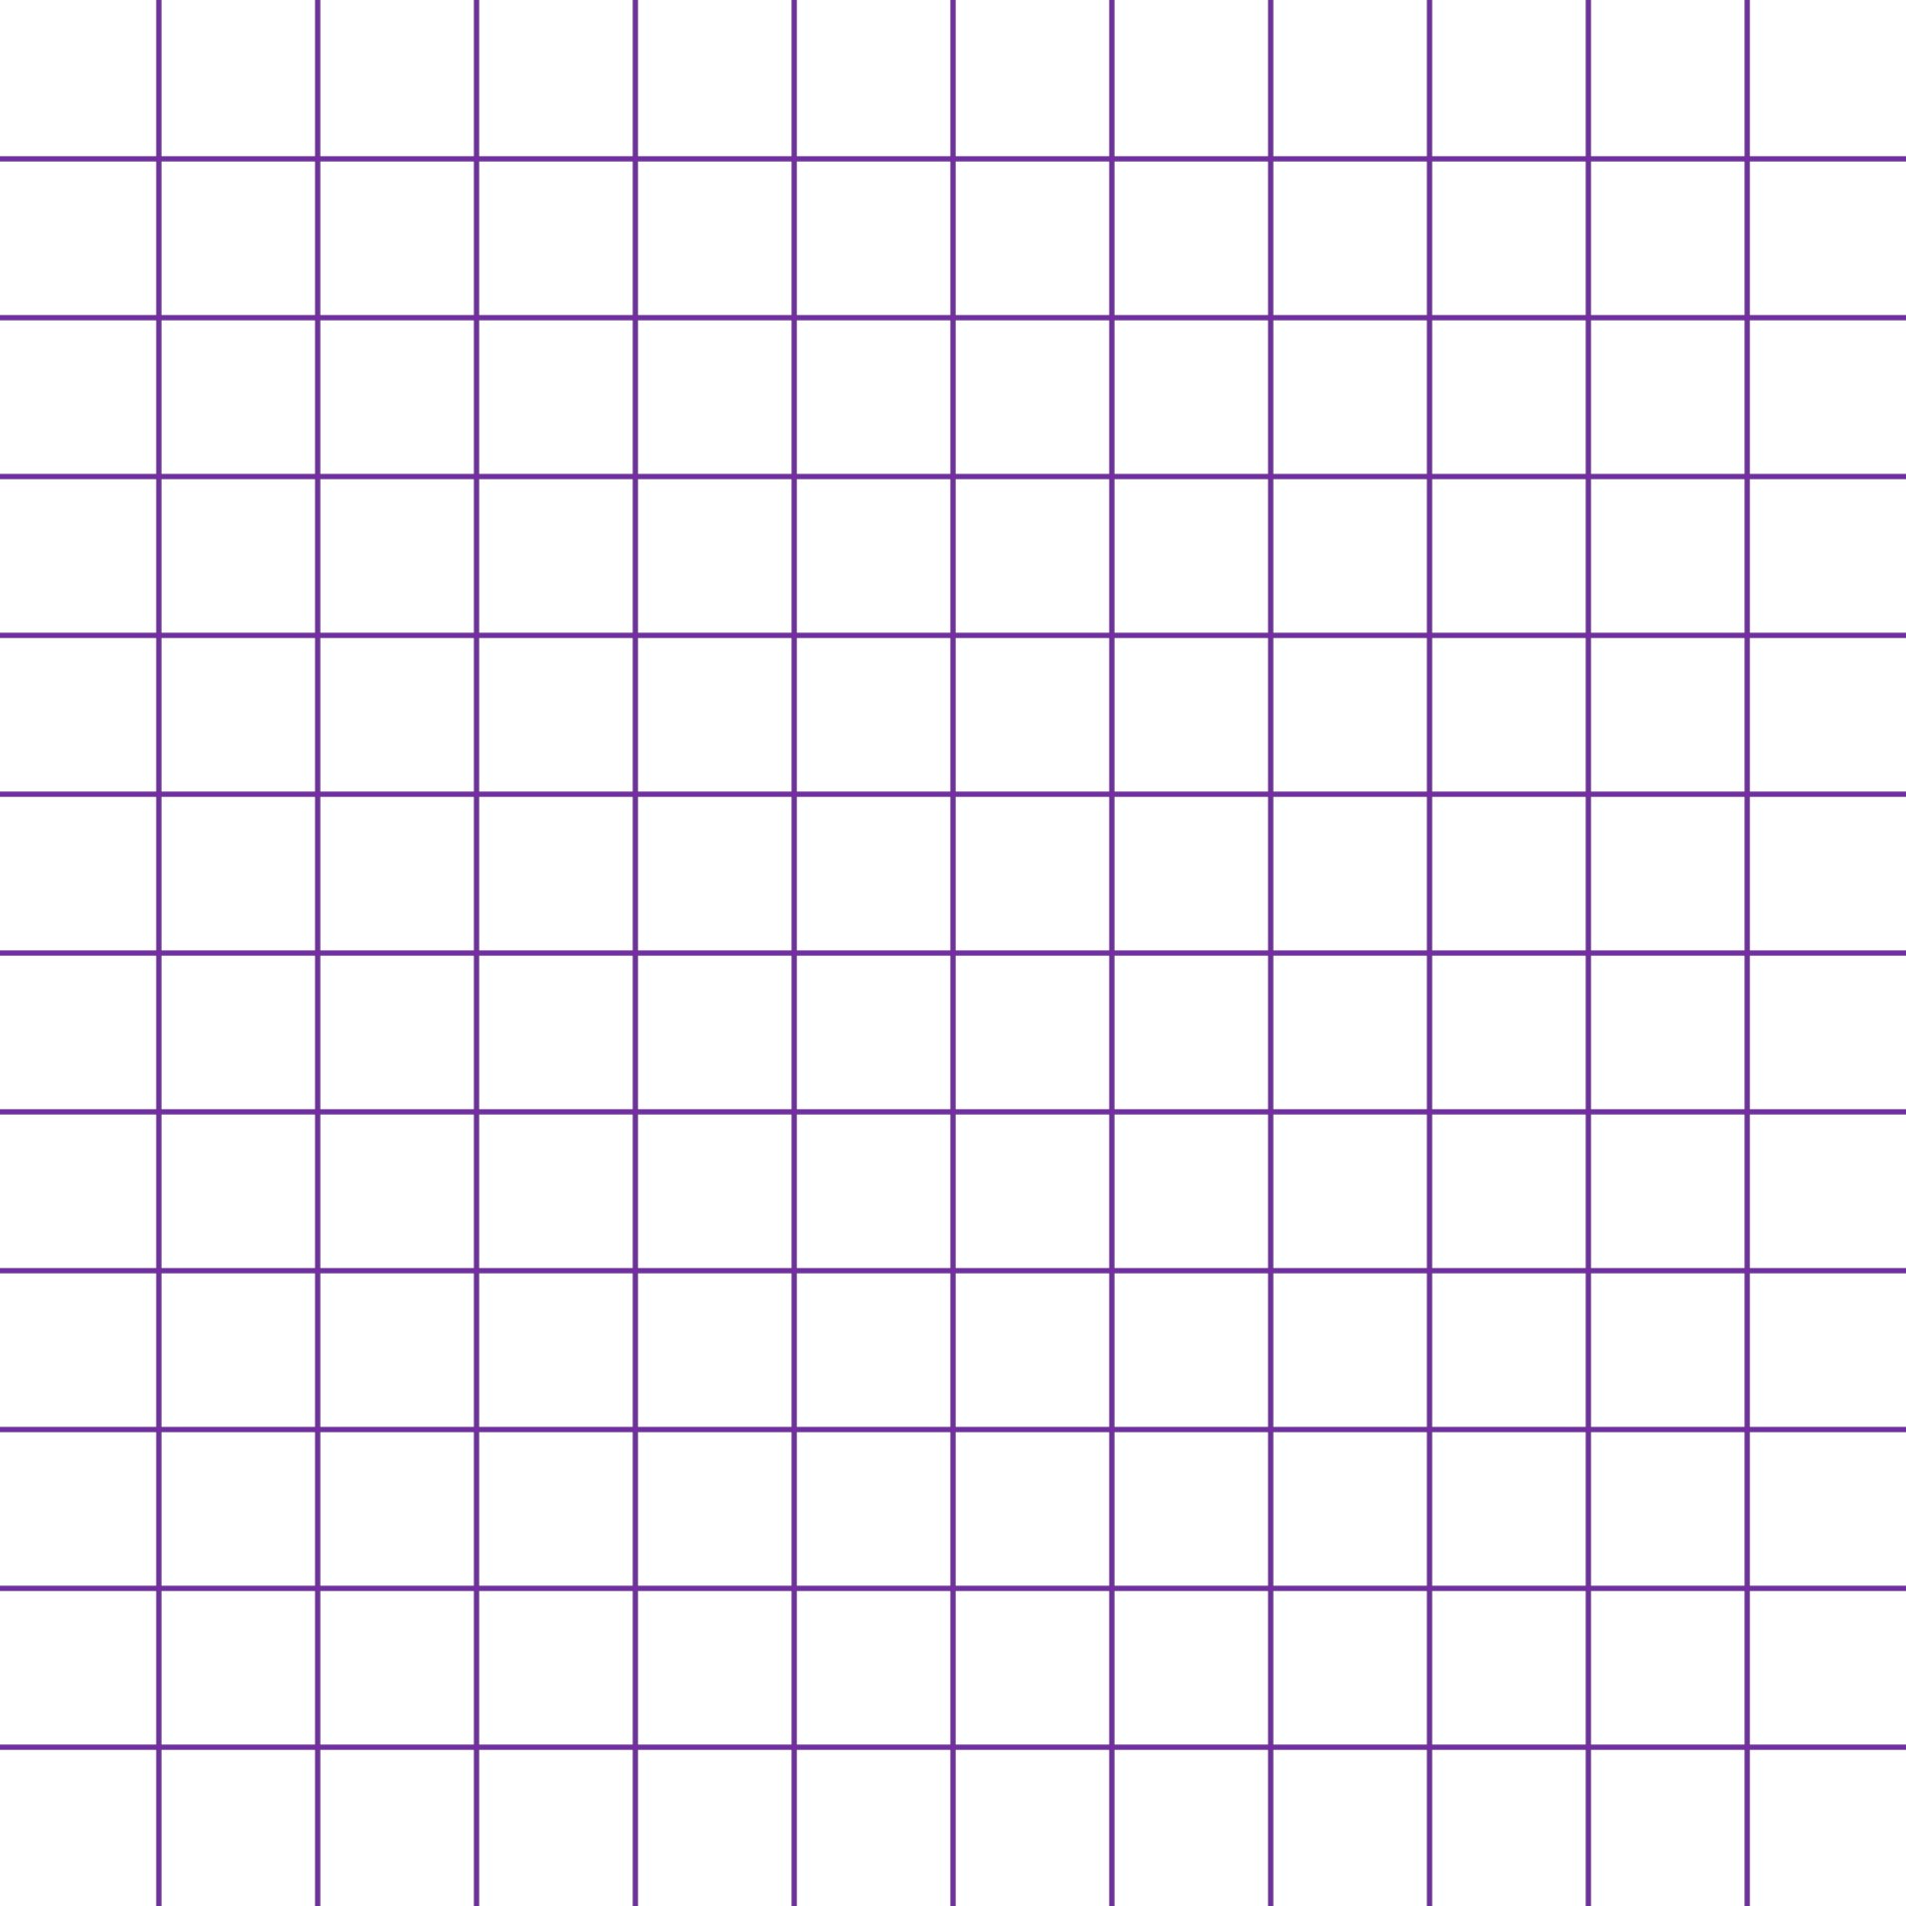
When to use two-dimensional arrays?
Foreach and Multidimensional Arrays
Imaging: two-dimensional arrays can be used to manipulate image or picture data.
Each pixel can be assigned specific values or information that can be stored in a two-dimensional array. This allows various operations such as filtering, contradiction search or image manipulation.

Slide 12

Foreach and Multidimensional Arrays
Task 2
The program asks you to enter the number of rows and columns. After inputting, you should create an array of the given size, the program should then ask you to enter the number/value of each element and print a matrix from the given numbers in example: Enter 2 2. Then Enter 1, 2, 2, 3
Write a method to find all repeated numbers in a given two-dimensional array
Write a method to find all repeated names in a given two-dimensional array
You have two arrays: A with size 3x3 and B with size 3x1. Write a program that performs the addition of the arrays (A * B) and displays the result.

Slide 13

Foreach and Multidimensional Arrays
Task 3
Write a method to find and display the maximum value of a two-dimensional array and its position (row and column numbers).
Create a program that reads a 3x3 array and checks whether it is symmetrical (i.e. whether it is flat if you flip it horizontally or vertically). Display the result in the console.
Create a method that accepts the number of animals needed for the table. For each animal, the method should ask for the animal's name, type, coat colour, behaviour. The method should print this table.
You have an empty array "char[,] array = new char[4, 4];". Using "for" loops and "if" conditions, put the "*" and " " characters in the right places so that when the program is run, it will output to the screen:

Slide 14
Foreach and Multidimensional Arrays
Project 1
Create a "tick-tack-toe" game.
The game should allow two players. The program should bring up a menu and one of the menu options should be "New Game->Two Players", then the program should ask for the names of the players and keep track of their results. When the game starts the first player should enter the coordinates of the row and column where they would like to place the cross. The same process is followed for the second player. Don't forget validation.

Slide 15
Foreach and Multidimensional Arrays
https://learn.microsoft.com/en-us/dotnet/csharp/programming-guide/arrays/multidimensional-arrays
Useful information

